Slide 1
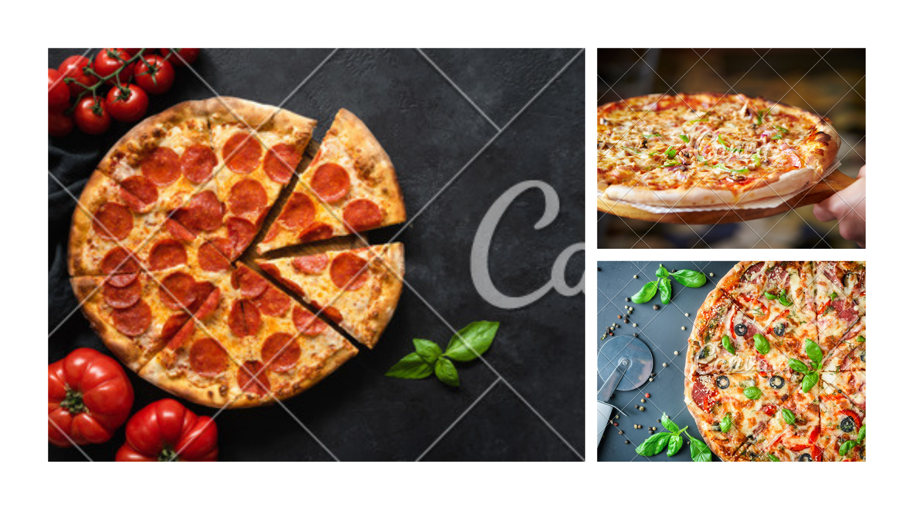
PIZZA PLACE SALES

Slide 2
I am pleased to present my first Excel analysis report, which examines Pizza Place Sales based on Kaggle(https://www.kaggle.com/datasets/mysarahmadbhat/pizza-place-sales). As you will see, this report provides a comprehensive overview of the key trends and patterns that emerged from the data, as well as recommendations for how to leverage this information to achieve promote some low demand product to promotion, understanding sales, budget tracking and profit analyses. Throughout this analysis, I utilized a range of Excel tools and techniques, including massive used of Pivot Table and charts to visualize data as well as I used sum, average, min, max , Lookup and many more function. By combining these tools with my analytical skills and expertise, I was able to extract meaningful insights from the data and create a report that is both informative and actionable. I hope that you find this report to be insightful and engaging, and that it provides a valuable starting point for further analysis and decision-making. Thank you for your attention, and please don't hesitate to contact me if you have any questions or feedback. Sincerely, Payal Gawande.

Slide 3
Step by Step Process
Initially I got 4 Different files Name as:- 1. Order 2. Order Detail_Id 3. Pizza 4. Pizza Type
In 4 Different files I am not able to analyse Data properly so I merge all of them in 1 File and 4 Different Sheet that makes my analyses work easier and give name them accordingly
My first sheet is Order there I have 3 column as follow:-
My Second Sheet is Order Details there I have 5 column as follow:-
Order_id - This column represent a total number of customers visit in show in 2015-2016
Date - This represent on which date customer visit in shop
Time - This represent time of costumers visit in shop
Order_details_id - This column represent a total number of customers visit in show in 15-16
Order_id - This represent a token id of customer for helping serving pizzas
Pizza_id - This represent a name and size of pizza , after pizza name here is suffix s,m,l that show size like small ,medium and large respectively
Quantity - This represent how many pizzas order by each customer
Date - This represent date of visit of costumers

Slide 4
Step by Step Process
My Third sheet is Pizza there I have 4 column as follow:-
My Fourth Sheet is Pizza Types Details there I have 4 column as follow:-
Pizza_id - This represent a name and size of pizza , after pizza name here is suffix s,m,l that show size like small ,medium and large respectively
Pizza_type_id - This represent a name of pizza
Price - This represent price of each pizzas
Size - This represent size of pizza with respect to pizza name of respective row
Pizza_type_id - This represent a name and size of pizza , after pizza name here is suffix s,m,l that show size like small ,medium and large respectively
Name - This represent a full name of pizza
Category - This represent category of each pizzas
Ingredients - This represent each pizza’s ingredients

Slide 5
Step by Step Process
My Fifth sheet is finale Resulted chart there I have 4 column as follow:-
Order Sequence/order Detail Id - This column represent a total number of customers visit in show in 2015-2016
Order_id - This represent a token id of customer for helping serving pizzas
Pizza Name - This represent a name of pizza
Size of Pizza - This represent a name and size of pizza , after pizza name here is suffix s,m,l that show size like small ,medium and large respectively
Quantity - This represent how many pizzas order by each customer
Pizza Full Name - This represent a full name of pizza
Category - This represent category of each pizzas
Ingredients - This represent each pizza’s ingredients
Price - This represent price of each pizzas
Date - This represent date of visit of costumers
Time - This represent time of costumers visit in shop

Slide 6
Question 1
THOUGHT POINT :- When we start our food business we start thinking that how frequently costumers are visiting in our shop. So our next step is the same we have range year 2015-2016 so have to calculate how many costumers were visited.
1. How many costumers do we have each day?
Ans:- 60 Customer each day visit to shop
Method:- With the help of Date, Month I count order_id, In this way I got that how many costumers visit on Jan-dec then I used average function and 60 customer visit each day to our shop. Table for calculation is present in sheet Order.
Chart No.:- 1

Slide 7
Question 2
THOUGHT POINT :- Now we understand at least 60 costumers are coming in our shop but suppose our chef or server are not present on that time when we actually required so for that we have to check the peak time, on which time in a day we received maximum number of order.
1. Is there any peak hour when we received maximum no. of order?
Ans:- Between 12-13pm
Method:- With the help of Time and count order_id in per hr, In this way I got that between 12 – 13pm people placed more order. This is my basic analyses that after 13pm people generally have there lunch so people love to have pizzas in their lunch time also. After that between 15-18pm also people placed more order and love to have pizza as snacks also. Table calculation done with help of time and order_id with is on sheet Order.
Chart No.:- 4

Slide 8
Question 3
THOUGHT POINT :-After solving problem of chef and servant requirement we have to focus on our food quality and materially availably so for we should know our best selling pizza, In this way we can improve our taste quality also
1. Do we have any best sellers pizzas?
Ans:- big_meat_s is best seller
Method:- With the help of Pizza_id and sum of quantity of each type of pizza,Table calculation done with help of Pizza_id and quantity on sheet Order Details .
Chart No.:- 5

Slide 9
Question 4
THOUGHT POINT : Definitely after getting best seller we eagerly wait to find out our total earning
1. How much money we make and more revenuer generated pizza ?
Ans:- 801944.7 USD Dollor , thai_ckn_l
Method:- With the help of Pizza Name, price and sum of quantity of each type of pizza we got Total Revenue, Table calculation done with help of Pizza_id and quantity on sheet Order Details .
Chart No.:- 2

Slide 10
Question 5
THOUGHT POINT : After making money we find best season for pizza selling business it will help us to introduce some idea or new pizza type in future.
1. Best season for Pizza ?
Ans:- July
Method:- With the help of Pizza Name, sum of quantity, Table calculation done with help of Pizza name size and quantity on sheet Pizzas .
Chart No.:- 3

Slide 11
Question 5
THOUGHT POINT : After making money, finding sales we have to think about our worst side also means which kind of pizza is not selling throuout the year.
1. Are there any pizzas we should take off the menu, or we have to need promotion ?
Ans:-
Method:- With the help of Pizza Name, sum of quantity, Table calculation done with help of Pizza name size and quantity on sheet Pizzas . This 3 kind of pizza have every low selling so according to business requirement either we have to cut this from menu or we have to take some action and start promoting the pizza.
Chart No.:- 6
the_greek_xxl | 28
green_garden_l | 94
ckn_alfredo_s | 96

Slide 12
Question 6
THOUGHT POINT : How many pizza at a time customer love to eat.
1. How many pizzas are typically in order ?
Ans:- 2
Method:- With the help of Pizza Name, sum of quantity, Table calculation done with help of Pizza name size and quantity on sheet Order Details .

Slide 13
Thank You

